Slide 1
Chapter 3
Implementing AAA in IOS
Cisco Secure ACS, RADIUS, and TACACS
Configuring routers to interoperate with an ACS server
Configuring the ACS server to interoperate with a router
Verifying and troubleshooting router-to-ACS server interactions
IIN3 Chapter 3-<number>

Slide 2


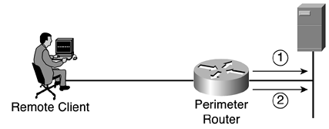
Server-Based AAA Authentication
Uses an external database server
  Cisco Secure Access Control Server (ACS) for Windows Server
  Cisco Secure ACS Solution Engine
  Cisco Secure ACS Express
More appropriate if there are multiple routers
Remote Client
AAA
Router
Cisco Secure ACS Server
1
2
3
4
Server-Based AAA
The client establishes a connection with the router.
The AAA router prompts the user for a username and password.
The router authenticates the username and password using a remote AAA server.
The user is authorized to access the network based on information on the remote AAA Server.

Slide 3


Overview of TACACS+ and RADIUS
TACACS+ or RADIUS protocols are used to communicate between the clients and AAA security servers.
Cisco Secure ACS for Windows Server
Perimeter
Router
Remote User
Cisco Secure
ACS Express
IIN3 Chapter 3-<number>

Slide 4
TACACS+/RADIUS Comparison
 | TACACS+ | RADIUS
Functionality | Separates AAA according to the AAA architecture, allowing modularity of the security server implementation | Combines authentication and authorization but separates accounting, allowing less flexibility in implementation than TACACS+.
Standard | Mostly Cisco supported | Open/RFC standard
Transport Protocol | TCP port 49 | UDP Authentication1645 or 1812 Accounting 1646 or 1813
CHAP | Bidirectional challenge and response as used in Challenge Handshake Authentication Protocol (CHAP) | Unidirectional challenge and response from the RADIUS security server to the RADIUS client.
Protocol Support | Multiprotocol support | No ARA, no NetBEUI
Confidentiality | Entire packet encrypted | Password encrypted
Command Authorization | Provides authorization of router commands on a per-user or per-group basis. | Has no option to authorize router commands on a per-user or per-group basis
Accounting | Limited | Extensive

Slide 5
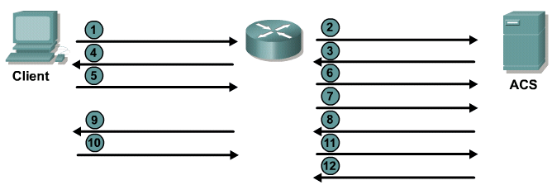
TACACS+ Authentication Process
Connect
Username prompt?
Username?
Use “Username”
JR-ADMIN
JR-ADMIN
Password prompt?
Password?
Use “Password”
“Str0ngPa55w0rd”
“Str0ngPa55w0rd”
Accept/Reject
Provides separate AAA services
Utilizes TCP port 49

Slide 6
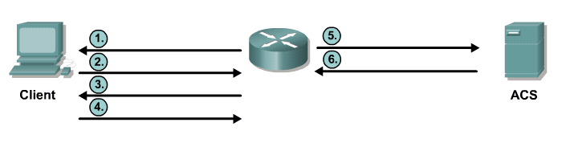
RADIUS Authentication Process
Access-Request
(JR_ADMIN, “Str0ngPa55w0rd”)
Username?
JR-ADMIN
Access-Accept
Password?
Str0ngPa55w0rd
Works in both local and roaming situations
Uses UDP ports 1645 or 1812 for authentication and UDP ports 1646 or 1813 for accounting

Slide 7


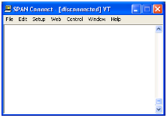
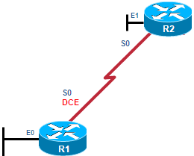
Authentication – Password-Only
Password-Only Method
User Access Verification
Password: cisco
Password: cisco1
Password: cisco12
% Bad passwords
Internet
R1(config)# line vty 0 4
R1(config-line)# password cisco
R1(config-line)# login
Uses a login and password combination on access lines
Easiest to implement, but most unsecure method
Vulnerable to brute-force attacks
Provides no accountability

Slide 8

Authentication – Local Database
Creates individual user account/password on each device
Provides accountability
User accounts must be configured locally on each device
Provides no fallback authentication method
R1(config)# username Admin secret Str0ng5rPa55w0rd
R1(config)# line vty 0 4
R1(config-line)# login local
User Access Verification
Username: Admin
Password: cisco1
% Login invalid
Username: Admin
Password: cisco12
% Login invalid
Internet
Local Database Method

Slide 9
Configure the Router to use ACS
Using AAA new-model
  Configures the router to look at the new syntax
Specify the tacacs or radius server details
  tacacs-server host 192.168.1.252 key cisco123
Create Authentication, Authorization and Accounting Policies
  Each Policy has a name and a method list, which supports fallback
aaa authentication login AUTHEN_via_TACACS group tacacs+ local
IIN3 Chapter 3-<number>

Slide 10
Configure the Router to use ACS
Policies are then applied as needed
  R1(config)# line vty 0 4
  R1(config-line)# authorization exec Author-Exec_via_TACACS
  R1(config-line)# login authentication AUTHEN_via_TACACS
IIN3 Chapter 3-<number>

Slide 11
Local AAA Authentication Commands
R1# conf t
R1(config)# username admin privilege level 15 secret cisco
R1(config)# aaa new-model
R1(config)# aaa authentication login AUTHEN_via_TACACS group tacacs+ local
R1(config)#
To authenticate administrator access (character mode access)
Add usernames and passwords to the local router database
Enable AAA globally
Configure AAA parameters on the router
Confirm and troubleshoot the AAA configuration

Slide 12
AAA Authentication
Command Elements
router(config)#
aaa authentication login {default | list-name} method1…[method4]
Command | Description
default | Uses the listed authentication methods that follow this keyword as the default list of methods when a user logs in
list-name | Character string used to name the list of authentication methods activated when a user logs in
password-expiry | Enables password aging on a local authentication list.
method1 [method2...] | Identifies the list of methods that the authentication algorithm tries in the given sequence. You must enter at least one method; you may enter up to four methods.
IIN3 Chapter 3-<number>

Slide 13
Method Type Keywords
Keywords | Description
enable | Uses the enable password for authentication. This keyword cannot be used.
krb5 | Uses Kerberos 5 for authentication.
krb5-telnet | Uses Kerberos 5 telnet authentication protocol when using Telnet to connect to the router.
line | Uses the line password for authentication.
local | Uses the local username database for authentication.
local-case | Uses case-sensitive local username authentication.
none | Uses no authentication.
cache group-name | Uses a cache server group for authentication.
group radius | Uses the list of all RADIUS servers for authentication.
group tacacs+ | Uses the list of all TACACS+ servers for authentication.
group group-name | Uses a subset of RADIUS or TACACS+ servers for authentication as defined by the aaa group server radius or aaa group server tacacs+ command.

Slide 14
Sample Configuration
R1# conf t
R1(config)# username admin privilege 15 secret cisco
  R1(config)# tacacs-server host 192.168.1.252 key cisco123
R1(config)# aaa new-model
R1(config)# aaa authentication login AUTHEN_via_TACACS group tacacs+ local
R1(config)# aaa authentication login AUTHEN_via_TACACS group tacacs+ local
R1(config)# line vty 0 4
R1(config)# authorization exec Author-Exec_via_TACACS
R1(config)# login authentication AUTHEN_via_TACACS
IIN3 Chapter 3-<number>

Slide 15
Sample Commands
R1# debug aaa authentication
AAA Authentication debugging is on
R1#
14:01:17: AAA/AUTHEN (567936829): Method=TACACS+
14:01:17: TAC+: send AUTHEN/CONT packet
14:01:17: TAC+ (567936829): received authen response status = PASS
14:01:17: AAA/AUTHEN (567936829): status = PASS
The debug aaa authentication command provides a view of login activity
For successful TACACS+ login attempts, a status message of PASS results

Slide 16
Sample Commands
R1# debug radius ?
accounting RADIUS accounting packets only
authentication RADIUS authentication packets only
brief Only I/O transactions are recorded
elog RADIUS event logging
failover Packets sent upon fail-over
local-server Local RADIUS server
retransmit Retransmission of packets
verbose Include non essential RADIUS debugs
<cr>
R1# debug radius
R1# debug tacacs ?
accounting TACACS+ protocol accounting
authentication TACACS+ protocol authentication
authorization TACACS+ protocol authorization
events TACACS+ protocol events
packet TACACS+ packets
<cr>
IIN3 Chapter 3-<number>

Slide 17
Testing ACS from Router
Ping the ACS
Test TACACS
R1# test aaa group tacacs+ admin cisco123 legacy
Use Debug to see details on the router
IIN3 Chapter 3-<number>

